Slide 1
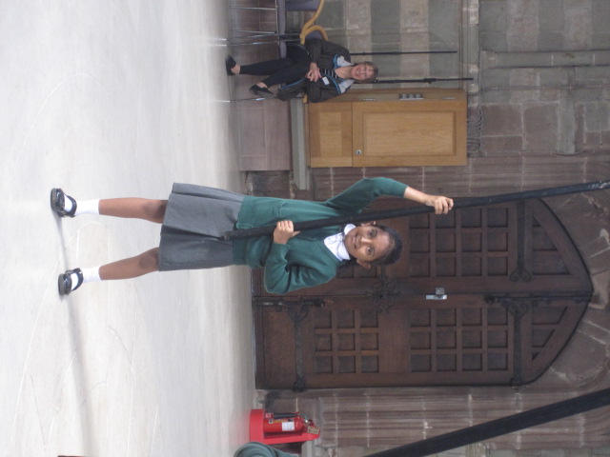
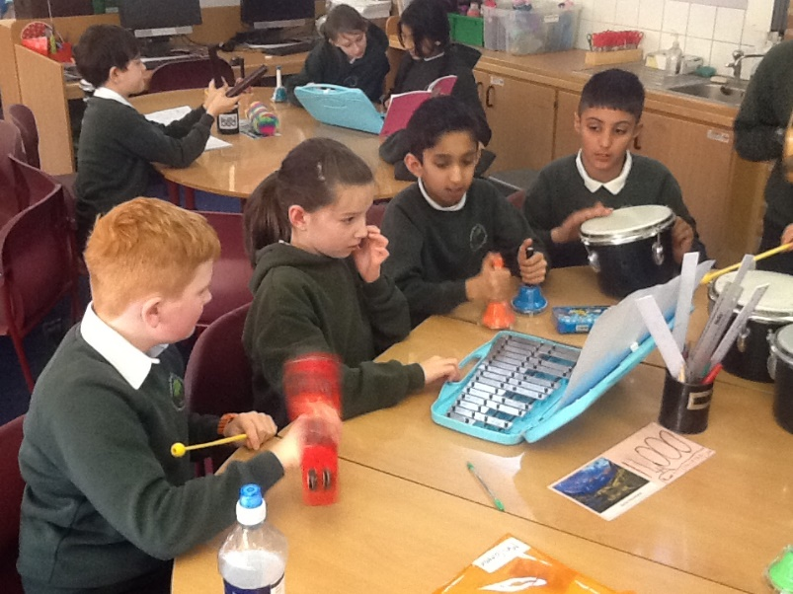
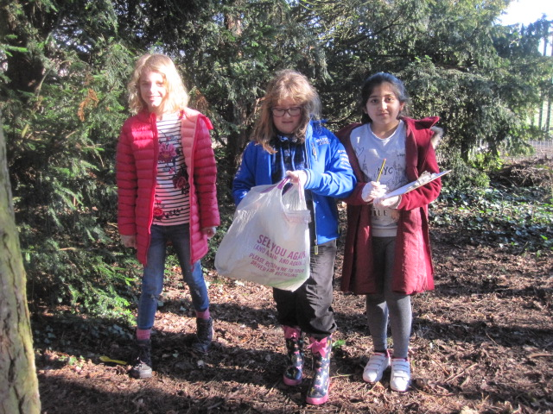
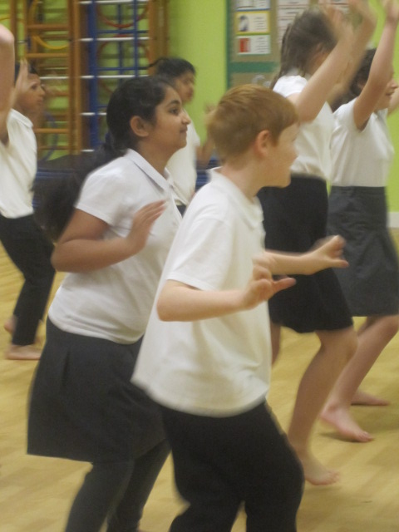
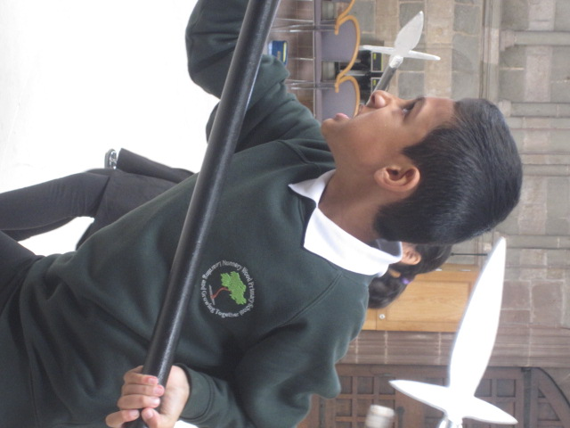
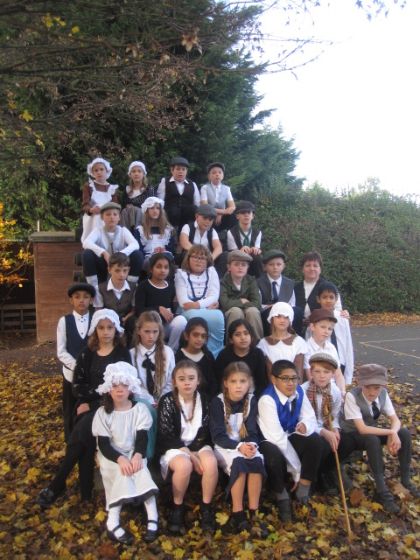
Welcome to Year 5!
Nunnery Wood Primary School

Slide 2
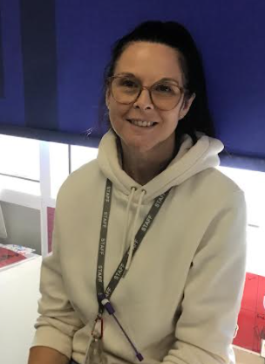
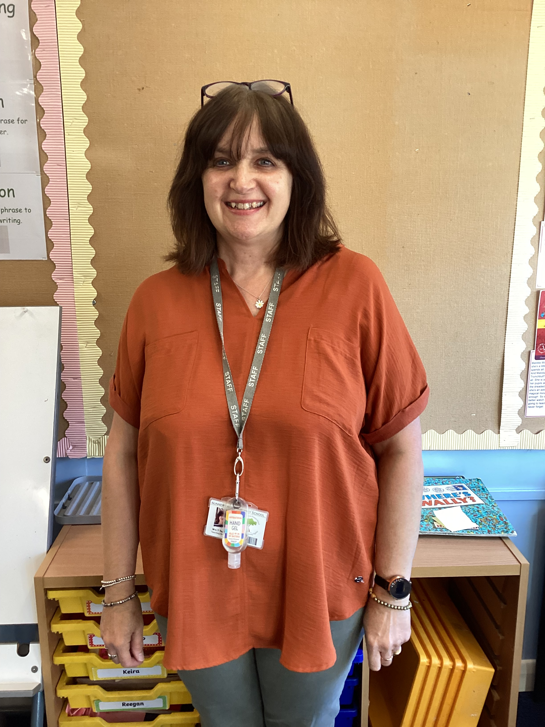
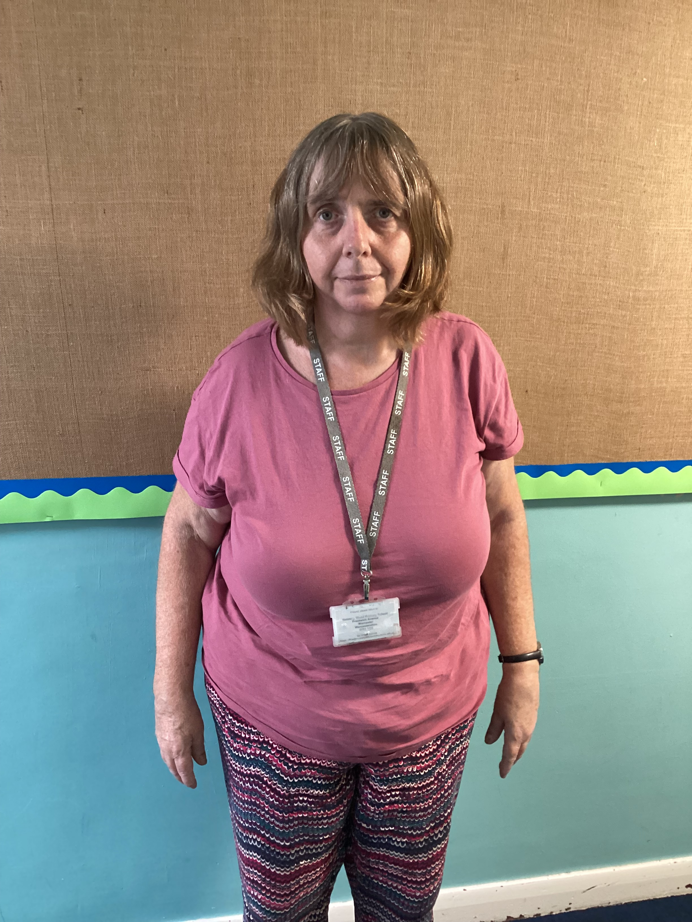
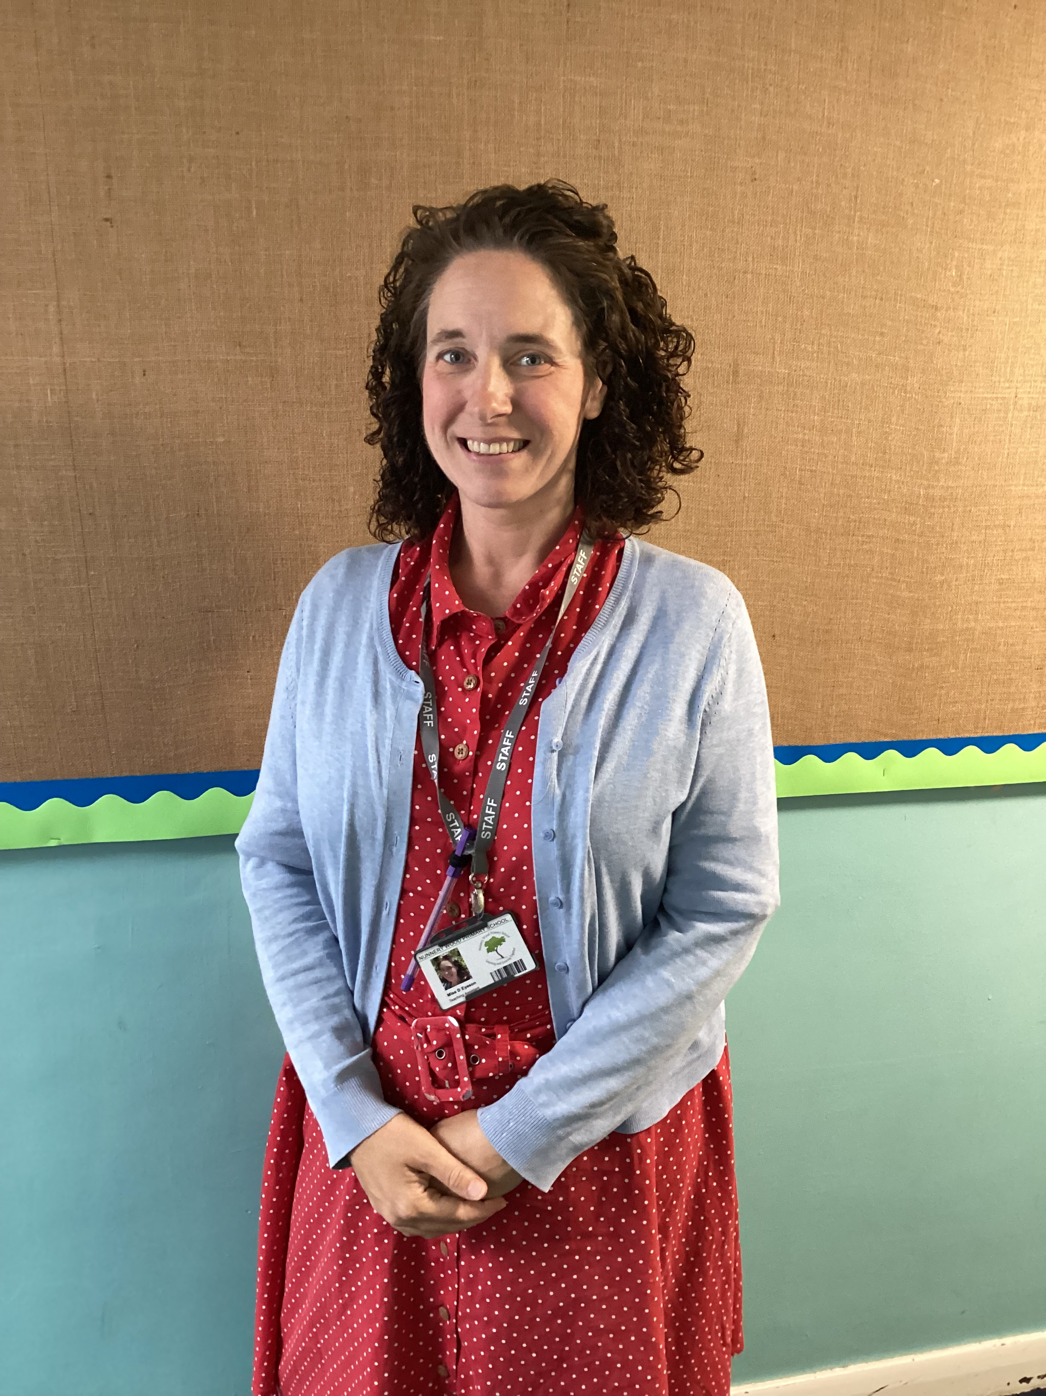
Staff in Year 5
Teachers – Mrs Marshall (Mon – Wed)
Scott Dodds (Mulberry)
Teaching assistants

Slide 3
Topics /Themes
Autumn | Spring | Summer
Civil War Victorians | Greeks Space Mountains | Fair Trade Rivers Animals & their habitats

Slide 4
Trips/Visitors –all TBC
Autumn | Spring | Summer
Worcester Civil war walk Bikeability (£) Carol service Mosque | Living History - Greeks(£) Planetarium(£) Swimming TBC (£) | Safari park (£) Geography field trip Trips to Nunnery Wood High School
If you are able to assist on trips and accompany us, we would be extremely grateful if you could let us know.

Slide 5
Timetable/routines:
Swimming
Friday afternoon.
TBC once pool reopens after Christmas
PE
Outdoor – Monday
Indoor – Friday
Woodland (2 terms of the year - fortnightly)
To begin in the Spring term.
For either the AM or the PM
Day to be confirmed

Slide 6
Home learning in year 5:
Reading | 5 weekly reads at home & 3 unknown words BRING READING JOURNAL IN EVERY FRIDAY
Maths & English | 1 piece of work every other week (alternating between) BRING HOME LEARNING BOOK IN EVERY TUESDAY FOR SHARED MARKING AND NEW HOMEWORK ON A WEDNESDAY
Home learning club - Tuesdays

Slide 7
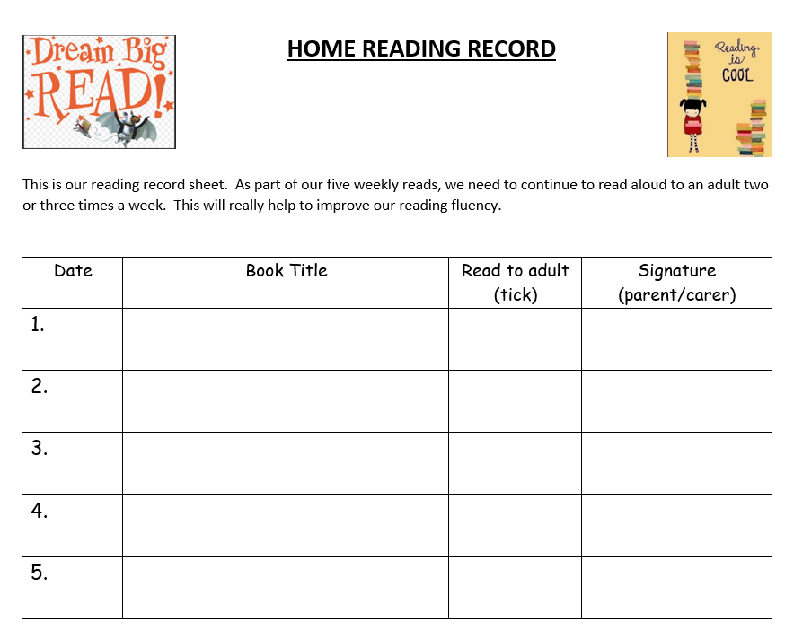
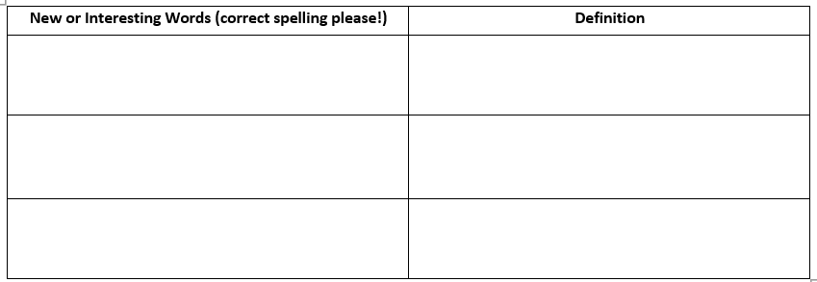
Reading
5 times a week for 10 minutes
Recorded in their reading record, children are encouraged to record themselves and an adult sign weekly. Will be checked in school on a Friday.
Can read to themselves but try to listen to them 2/3 times a week
Encouraged to read their ‘scheme’ book (if applicable) but to also read widely and for pleasure
Children bring their book and reading record in each day (keep in bag)

Slide 8
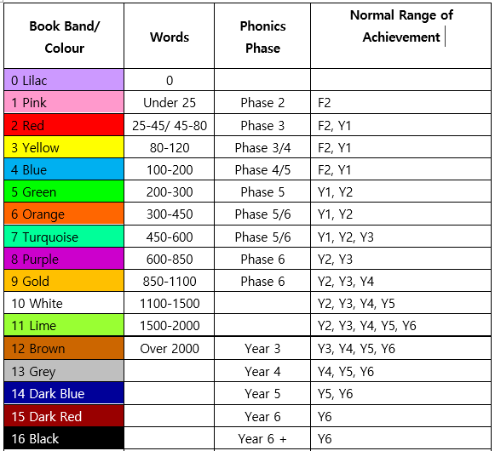

Reading
We follow a progressive scheme to ensure children are reading a book suitable for their current ability (over age) and to ensure good progress
Free
choice

Slide 9


Recommended
reads

Slide 10
Supporting your child in year 5:
Continuing to practice times tables (TTRS, hit the button etc)
Everyday maths – time, money, measures (e.g. cooking)
Work on spelling and handwriting – encourage them to write and help spot and correct spellings
Read regularly (crucial) and widely – recommended reads
Visit museums/the library etc
Encourage them to be more independent – completing own reading journal, bringing home learning in on time etc

Slide 11
Rewards and sanctions in year 5:
Whole school behaviour policy & recognition board
Table points & VIPS
Book tokens and reading raffle
Secret student and ½ termly treats

Slide 12
Communication in year 5:
Maple/Mulberry news on class window
Emails NOT texts via Arbor (please use the office email only)
Termly newsletters
Webpage

Slide 13
Uniform in year 5:
Appropriate for season – hat/coat etc and named!
Appropriate footwear
Hair accessories – white, green, black only and small
Jewellery – NO earrings in PE
Nail varnish - none
Equipment – kept to a minimum. No pencil cases/big bags

Slide 14
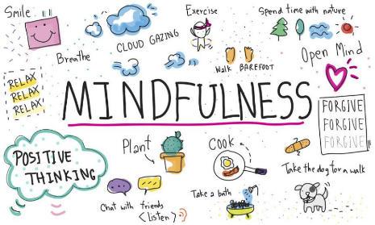
Mindfulness
We aim to do regular mindfulness activities to help the children learn how to self-regulate and self-calm.
Activities used regularly in Y5;
Mindful colouring
Listening to the chime
Breathing techniques
Mindful minute activities

Slide 15
Our priorities for the year:
Independence
Attendance
Reading
Times tables

Slide 16
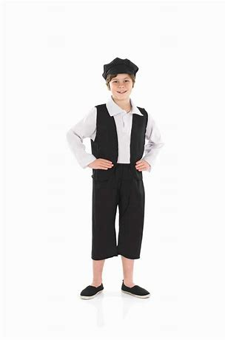
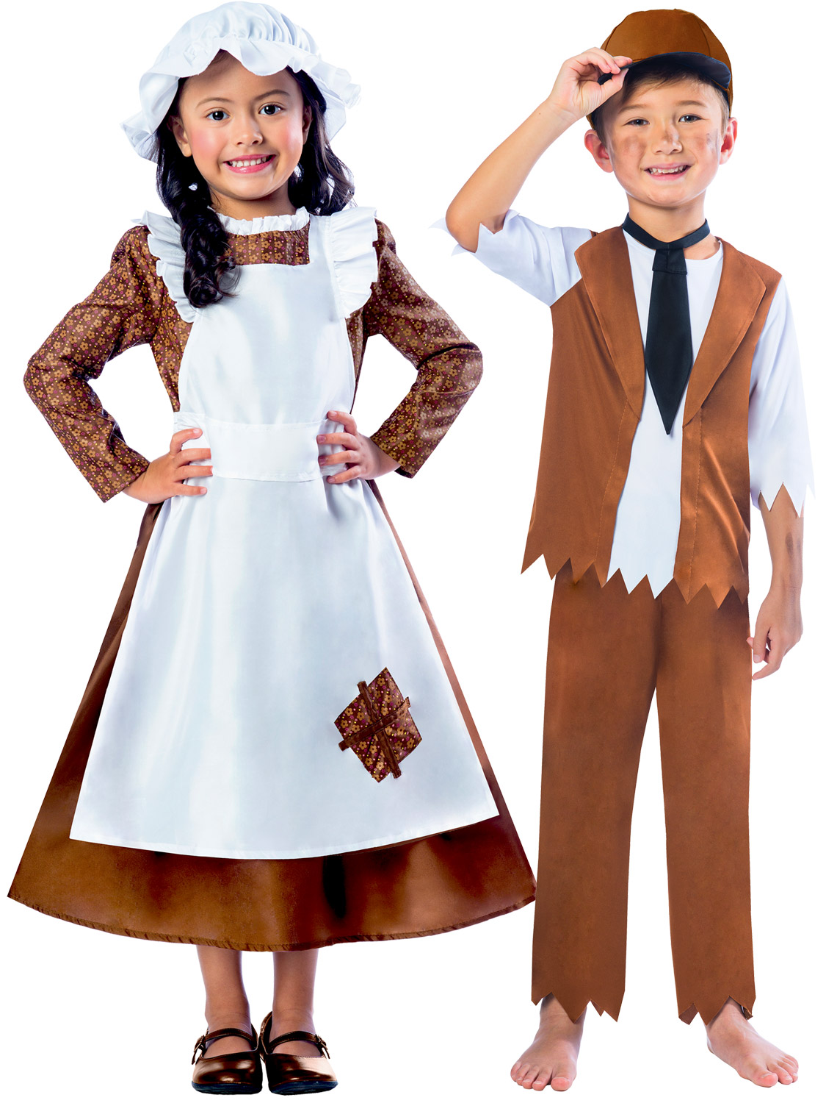
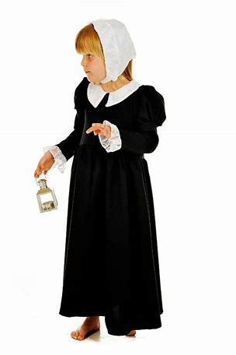
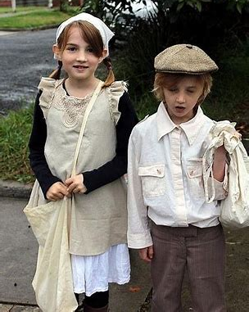
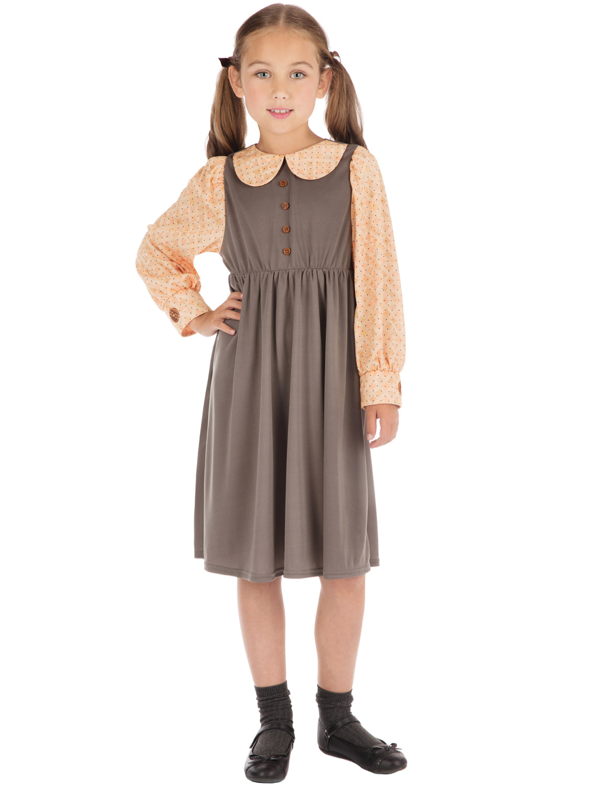
Victorian school day– After half-term

Slide 17
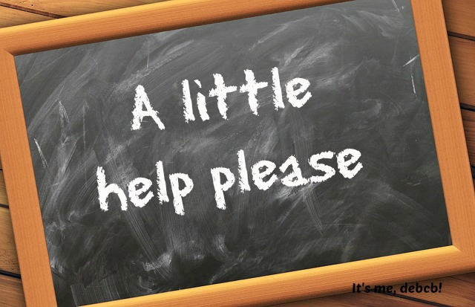
Worcester Civil walk trip
Wednesday 27th September

Slide 18
Thank you for coming.
Any Questions?

